Slide 1
Information Technology Institute (ITI)
Virtual Office Management
Session 10.3 - MS 365 Apps
ITI 490 Virtual Office Management - with Microsoft 365
(formerly Office 365)
Notes:
CANNOT EDIT PURPLE SHAPES OR LOGO
DIVIDER LINE IS EDITABLE
TO CHANGE IMAGE, RIGHT CLICK IMAGE, SELECT “CUT” TO REMOVE EXISTING IMAGE, AND CLICK IMAGE ICON TO INSERT NEW IMAGE
IF NO IMAGE IS IN PLACE, CLICK IMAGE ICON TO INSERT IMAGE

Slide 2
MS 365 Apps

Slide 3
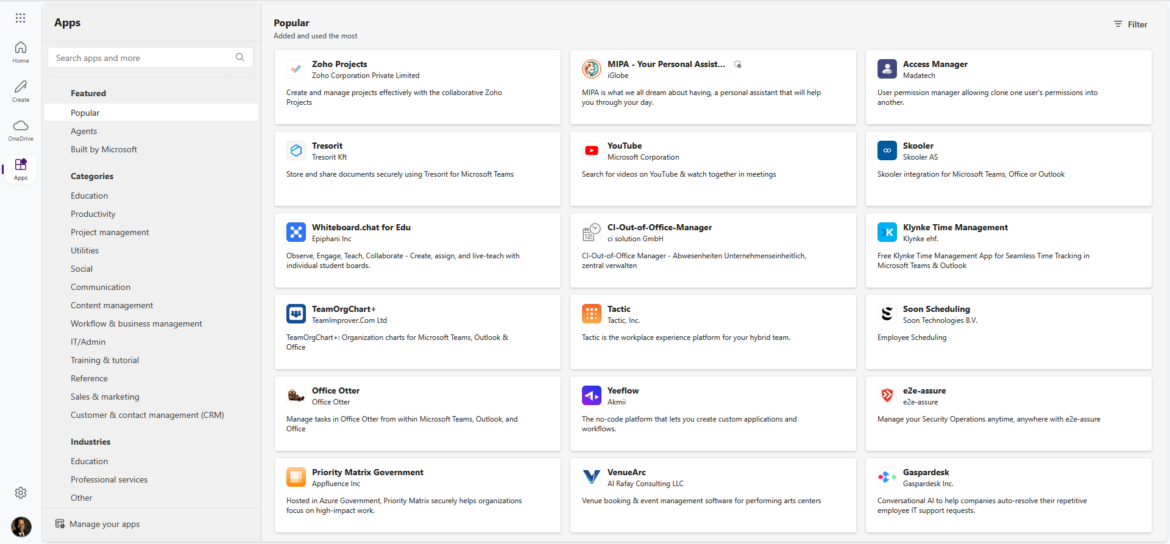
MS 365 Apps

Slide 4
Course Review
2/17/2025 - Session 1: Course Intro/Overview & OneDrive & File Management
2/19/2025 - Session 2: Word Part I
2/24/2025 - Session 3: Word Part II
2/26/2025 - Session 4: Excel Part I
3/ 3/2025 - Session 5: Excel Part II
3/ 5/2025 - Session 6: PowerPoint I
3/10/2025 - Session 7: PowerPoint II
3/12/2025 - Session 8: Outlook: Email
3/17/2025 - Session 9: Outlook: Calendar & People
3/19/2025 - Session 10: Teams & Preview of other features (OneNote, PowerApps, etc.) & Evaluations

Slide 5
Course Evaluation
CRN Number: 33957
Course Name: Virtual Office Management
Course Start Date: 2/17/2025
Course Instructor: Carl Burnett
Evaluation Address:
Link to Course Evaluation
https://forms.office.com/pages/responsepage.aspx?id=Cx5ATVJlCE69OKjRXKDd2ajBZeuNGUpCr1Y3iAmNkm5UNlBQQlVaWEtJUkY0MUFTV0UwU1ZaUzk3QS4u

